Slide 1

Wel Come
LockThreat Technologies

Slide 2
Introduction to EC2

Slide 3
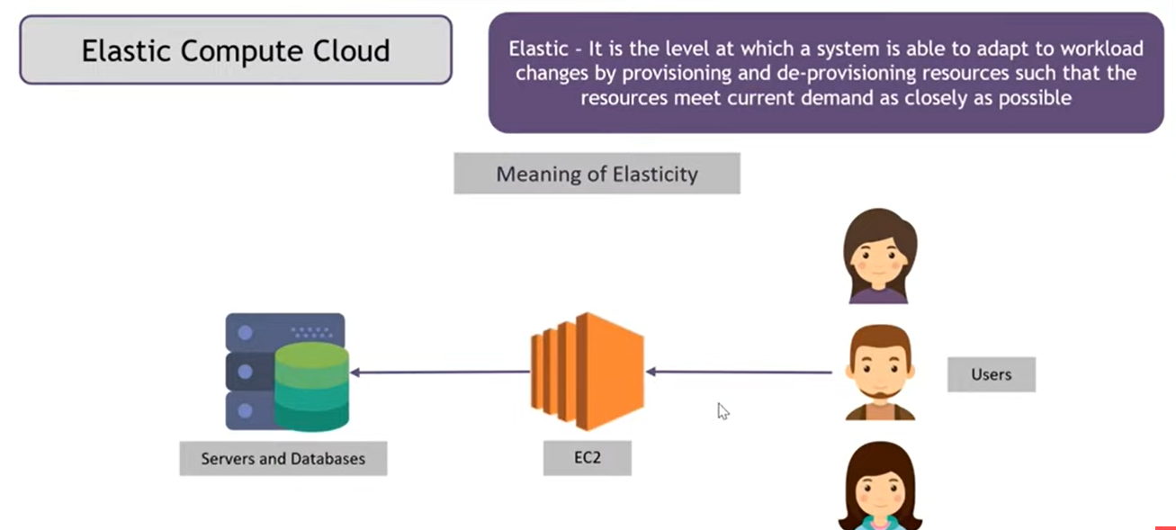
If you have 5 servers to host a your web server, then you want 6th server because of web search popularity increasing then user traffic will be more, in that case you need another server, so here you purchase, bring it, configure it, update software's, push a code into it, set it up, lets say after a week your website traffic goes down by 50%, in that case you need only 3 servers, remaining 3 servers you could not sale because of your invested, to solve this problem EC2 here

Slide 4
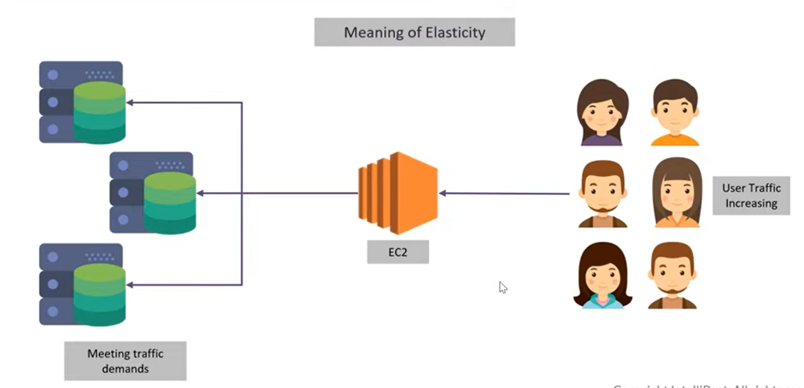
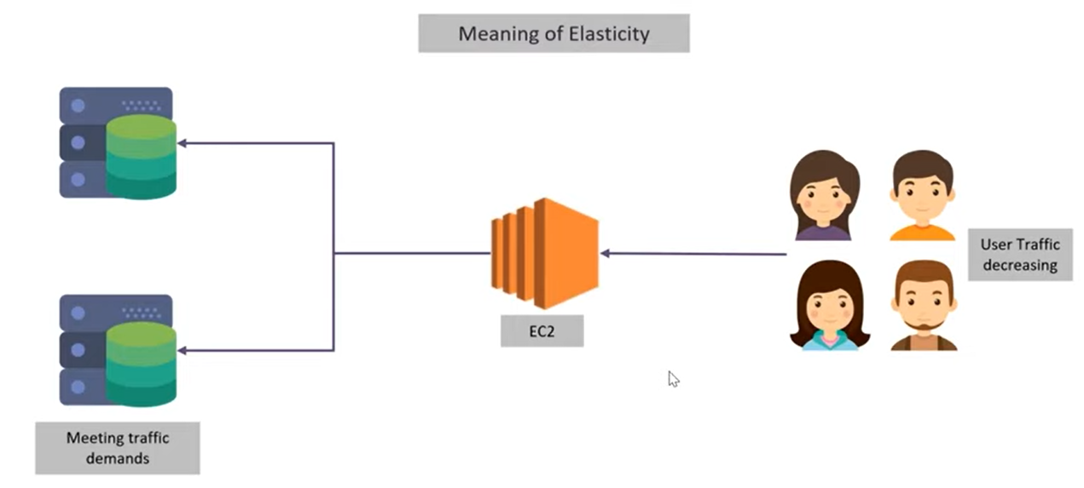
How EC2 works

Slide 5
What is EC2 ?
Elastic Compute Cloud is used to launch virtual Servers when on demand.
Provides scalable computing capacity.
Faster development and deployment of applications.
Eliminates invest in hardware.
Configures security, networking and manage storage.

Slide 6
PRACTICAL

Slide 7
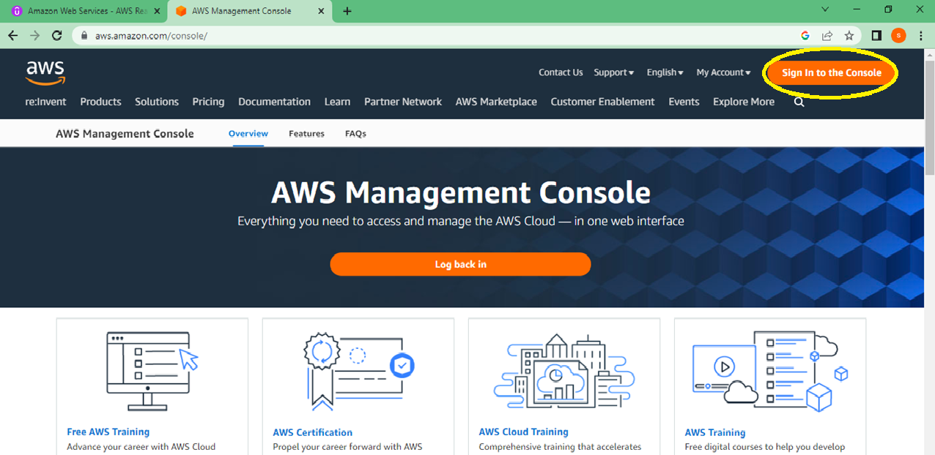
Open AWS Management Console in Google

Slide 8
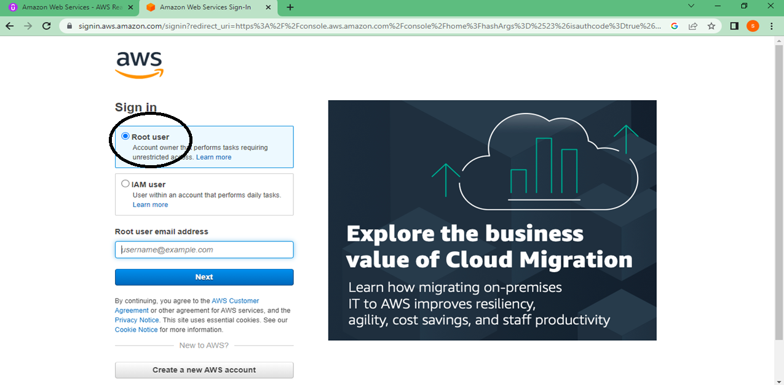
Always login in root user

Slide 9
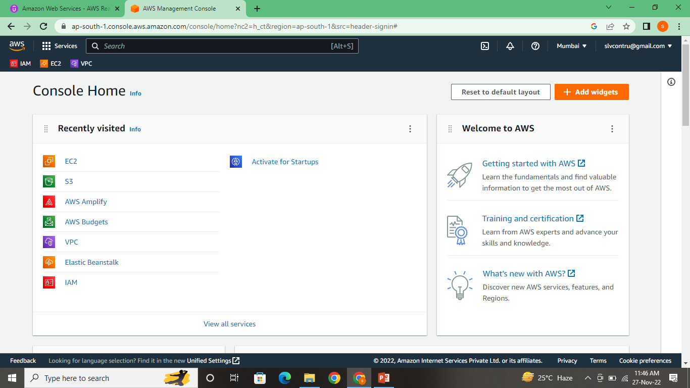
Once login you all VISIBLE to see AWS login page

Slide 10
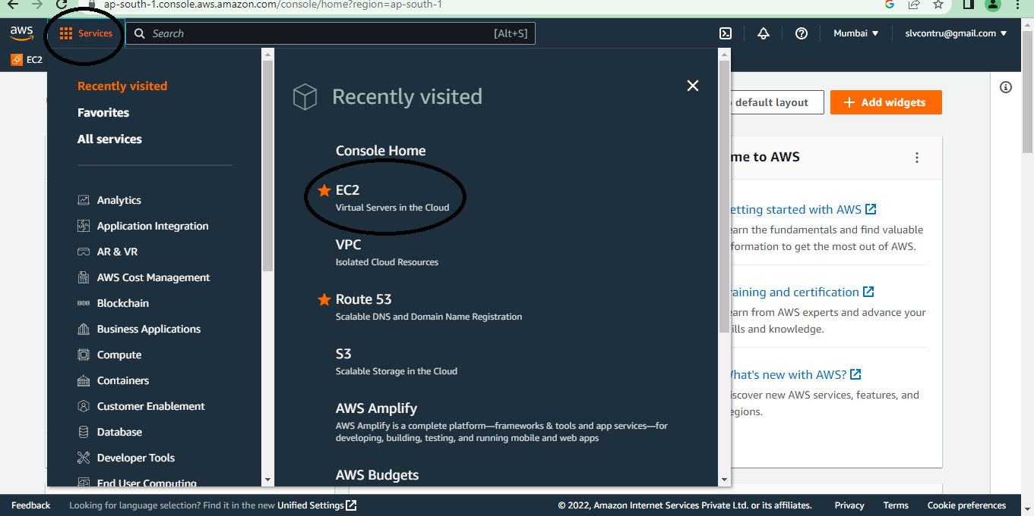

Slide 11
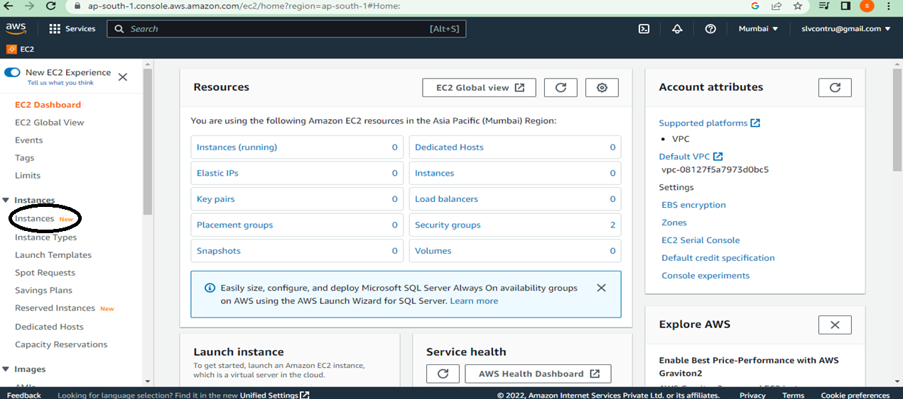
Launching EC2 system

Slide 12
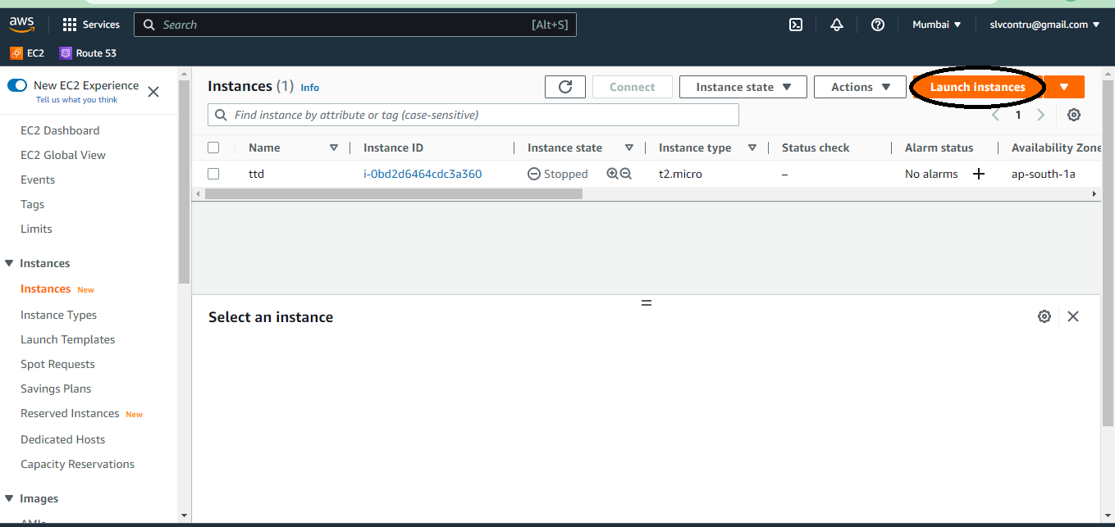

Slide 13
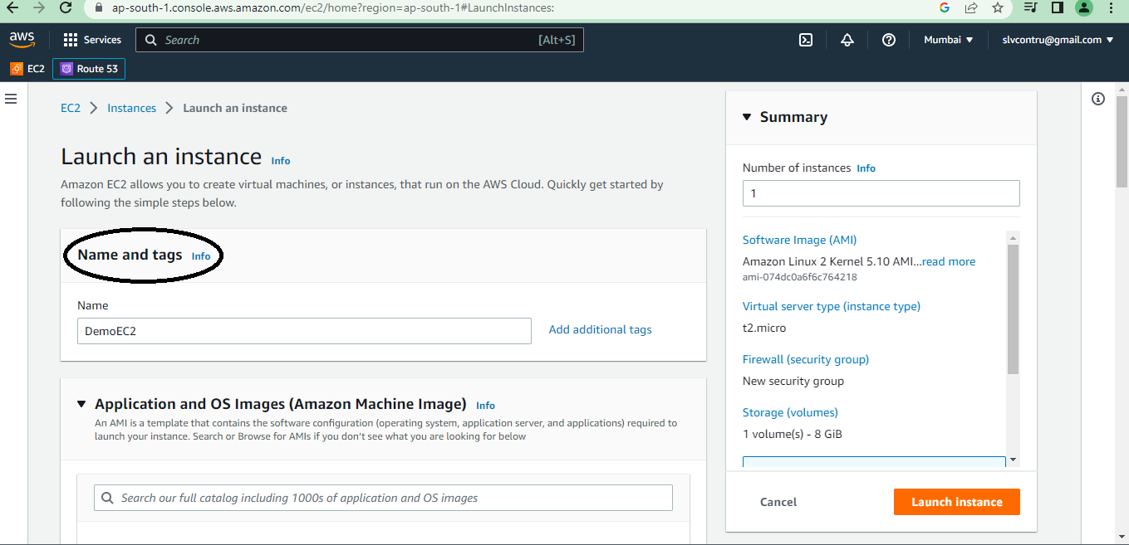

Slide 14
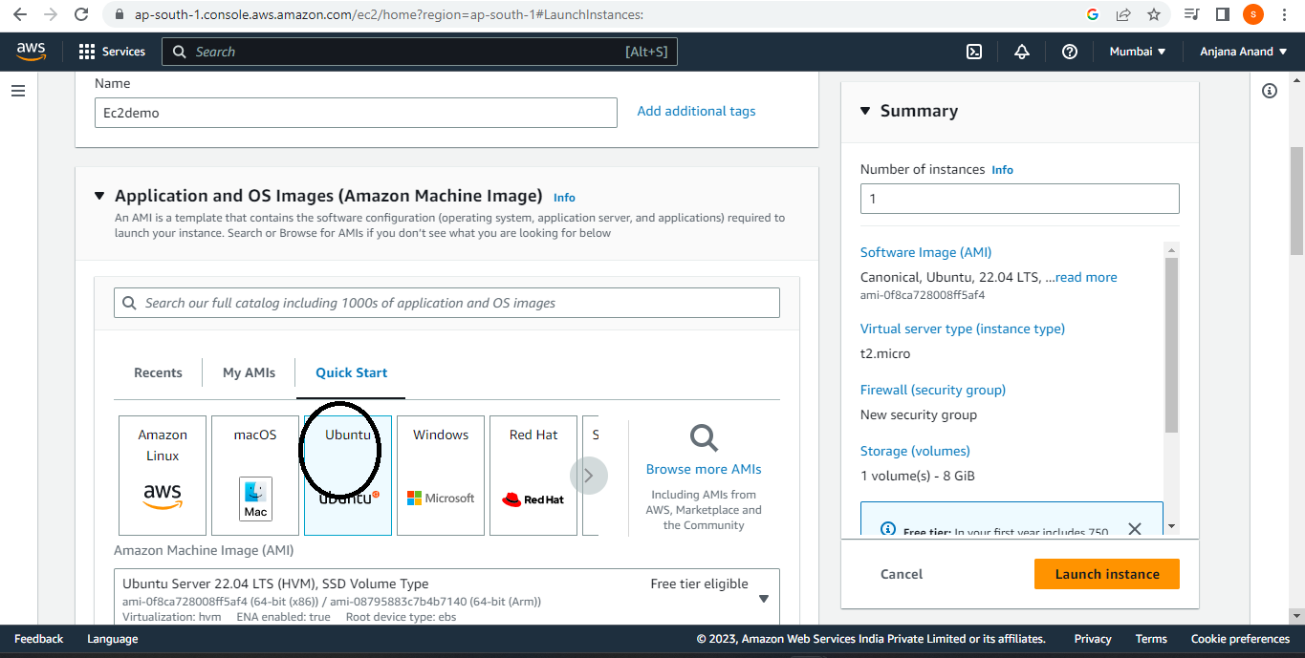
AMI is software & application packages/OS

Slide 15
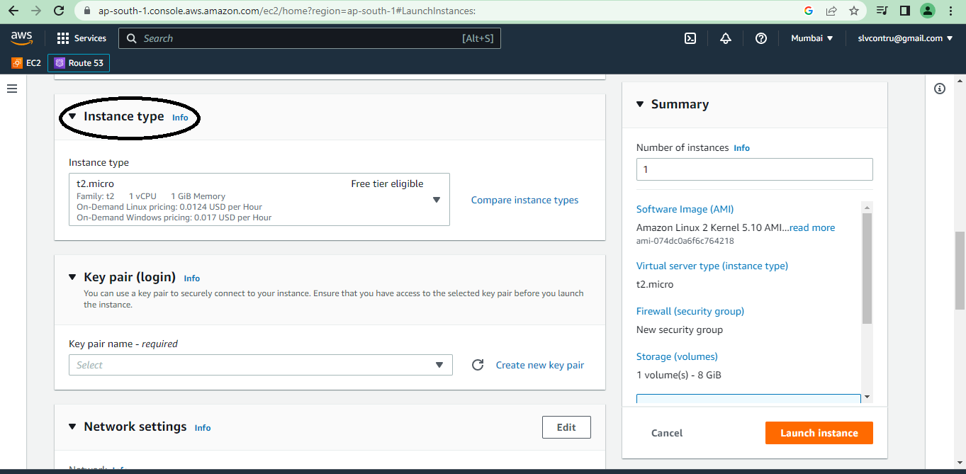
Instance type t2.micro is the Hardware

Slide 16
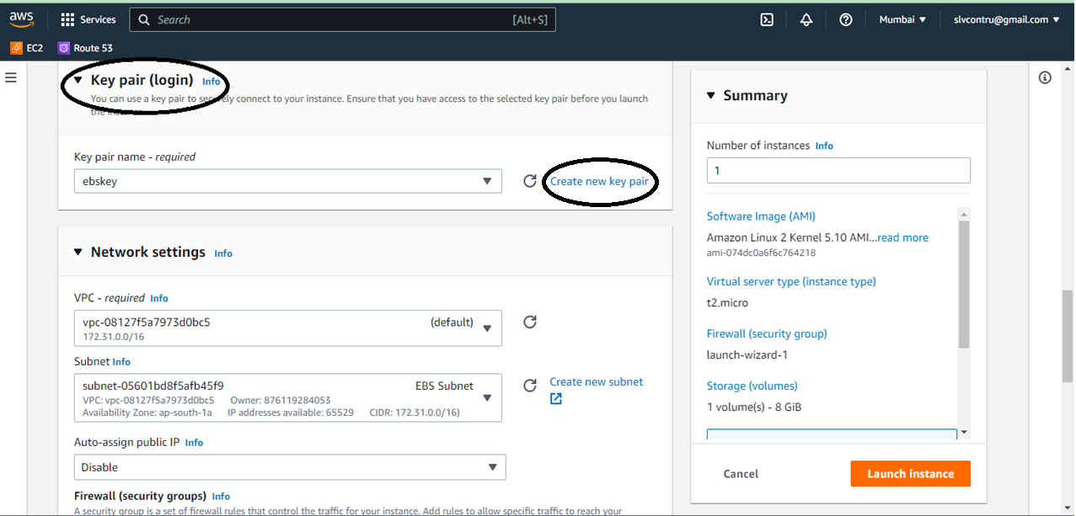
A key pair, consisting of a public key and a private key, is a set of security credentials that you use to prove your identity when connecting to an Amazon EC2 instance

Slide 17
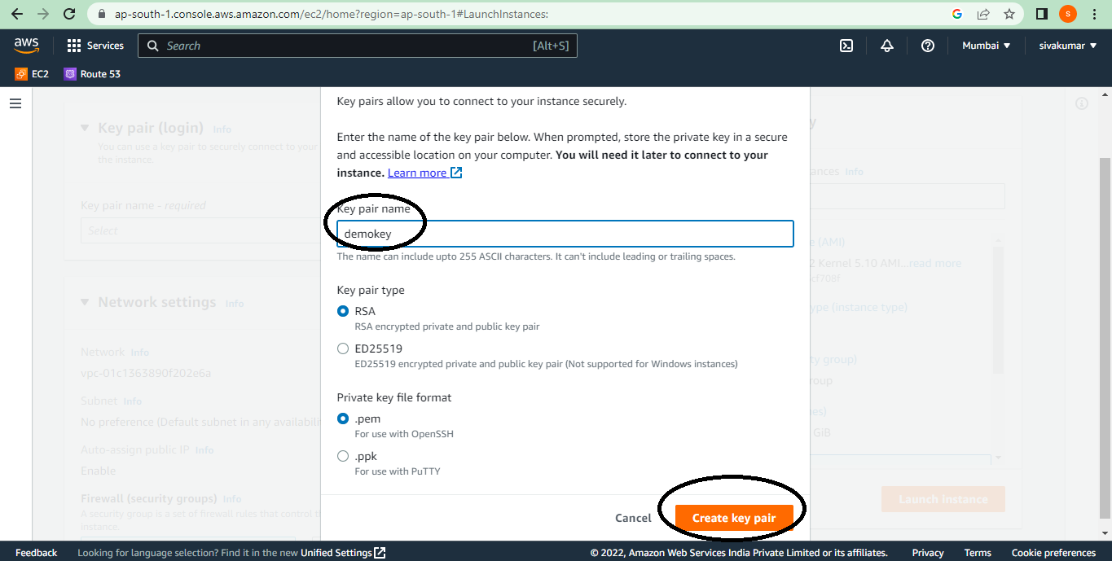

Slide 18
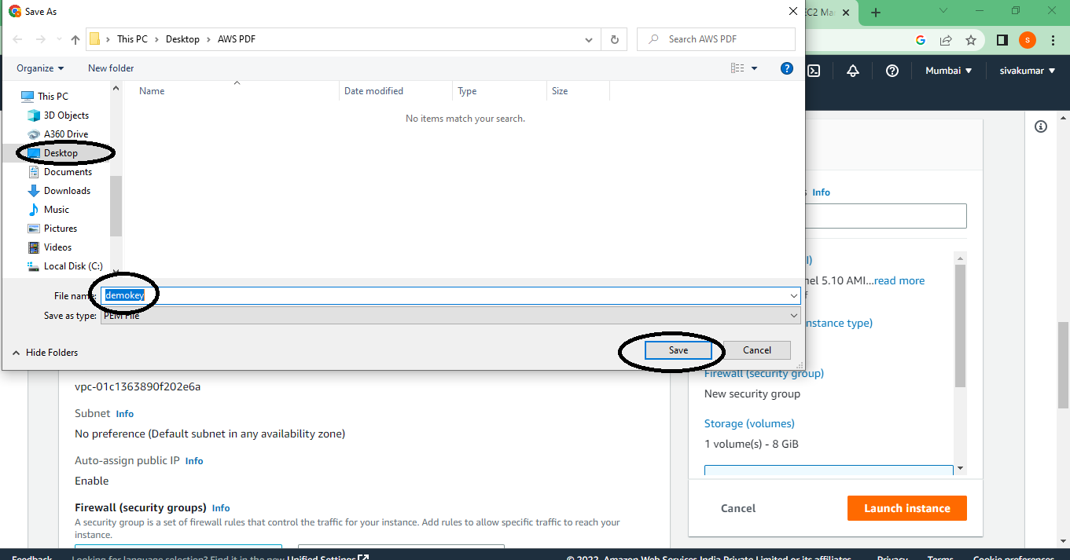
Once you create key pair please save it in desktop

Slide 19
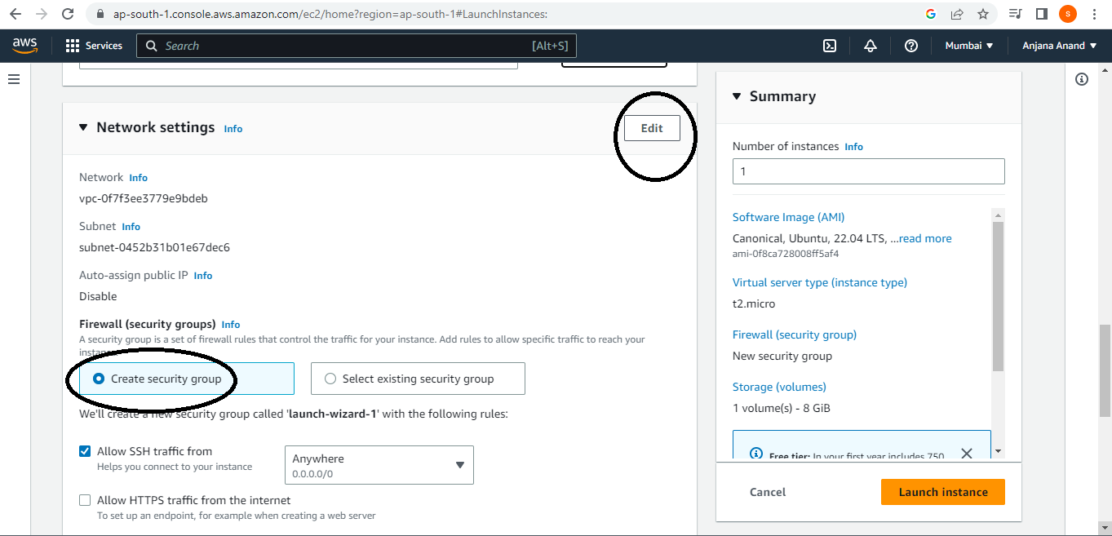

Slide 20
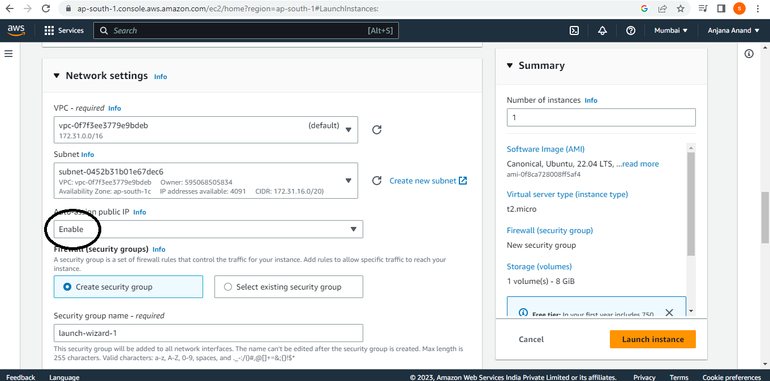

Slide 21
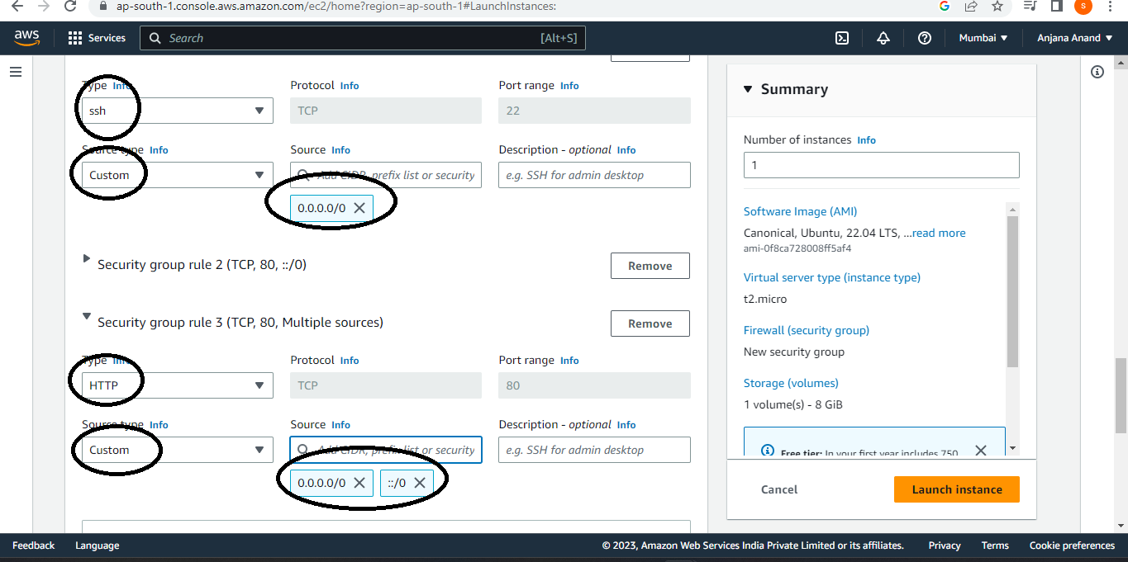

Slide 22
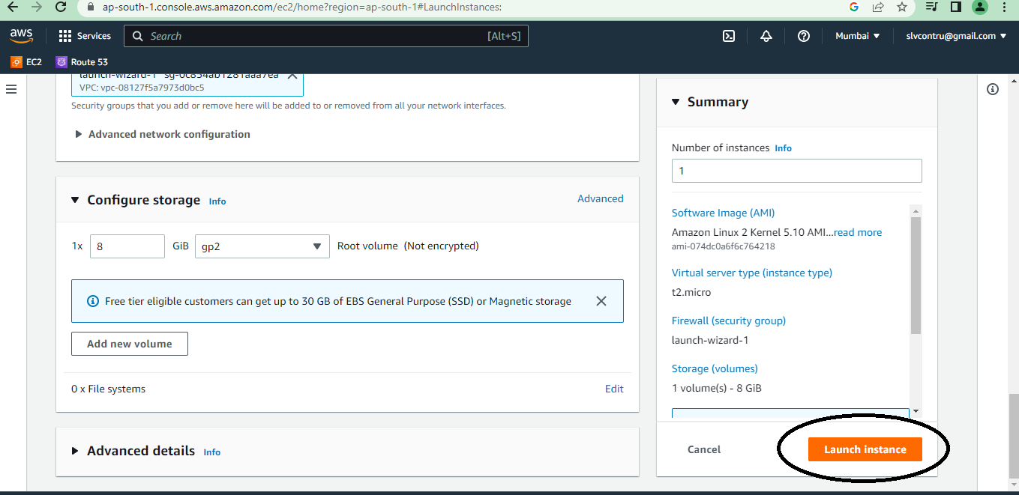

Slide 23
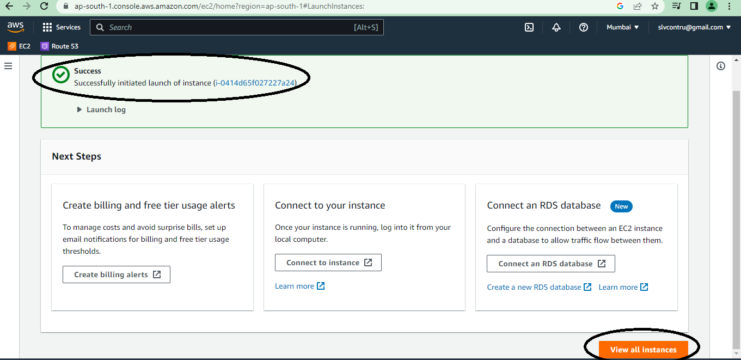

Slide 24
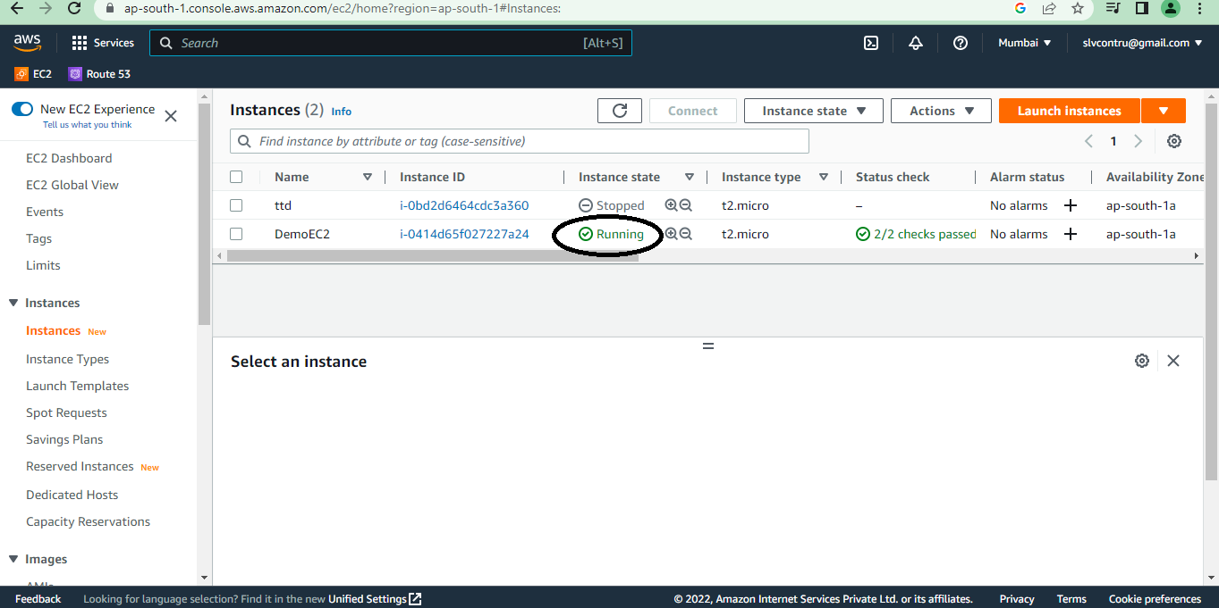

Slide 25
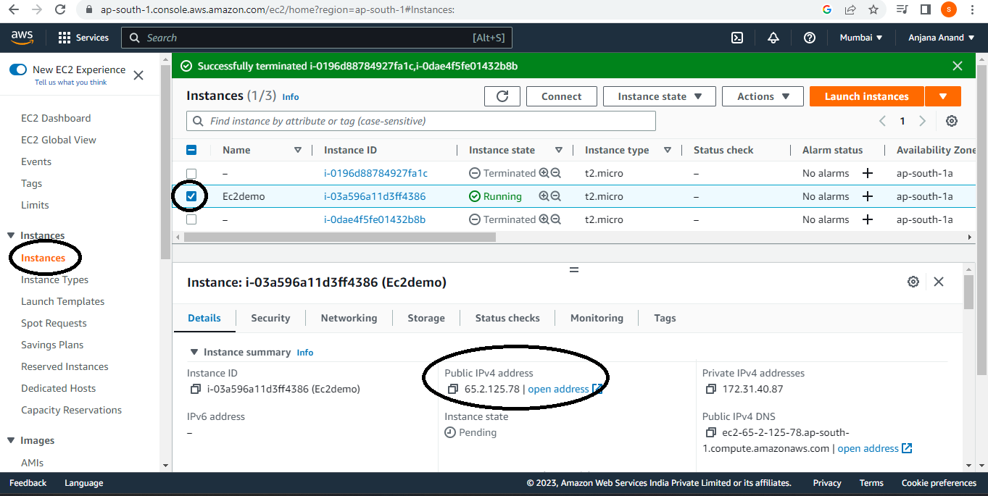
Copy public Ip address CHECK IN GOOGLE

Slide 26
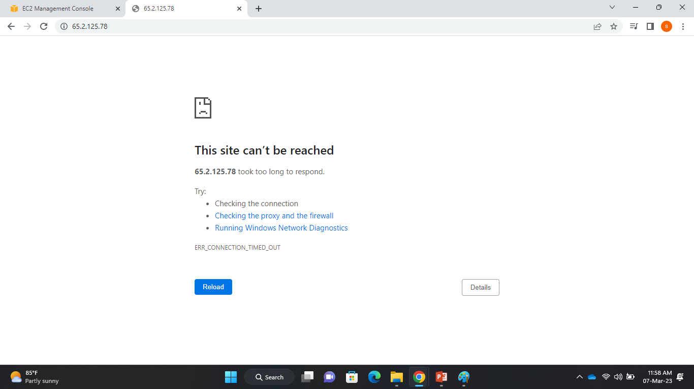
ERROR, WE DON’T HAVE ANY INSTALLATION PACKAGES IN SERVER

Slide 27
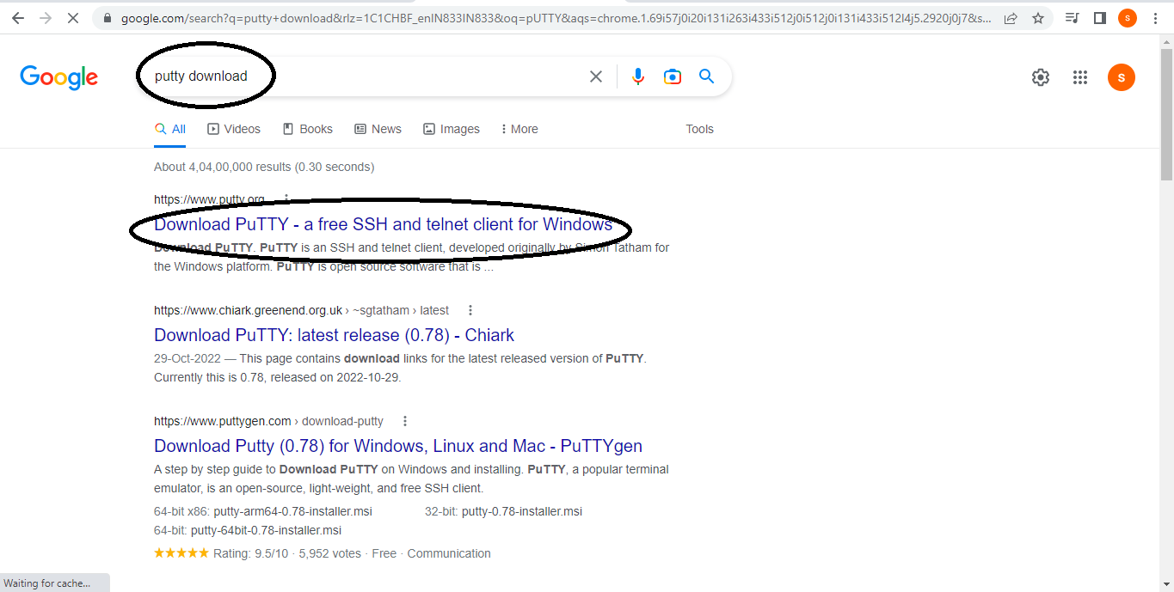
Download putty

Slide 28
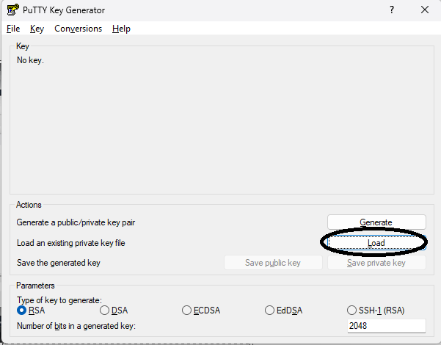

Slide 29
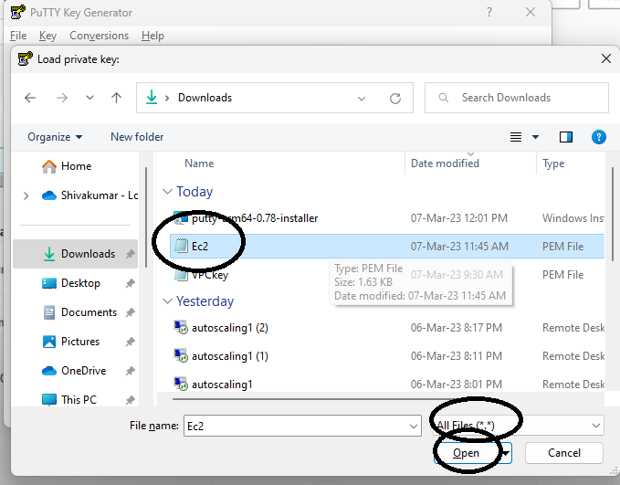

Slide 30
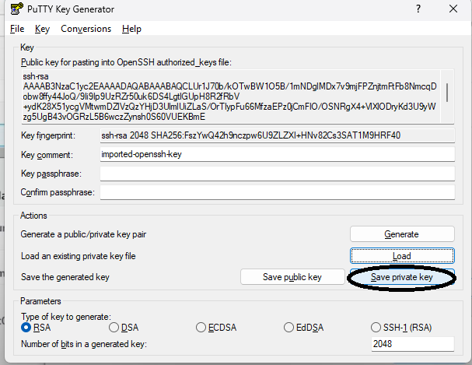
Close puttygen

Slide 31
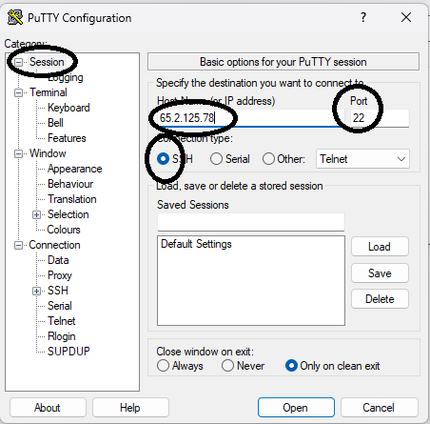
Next open putty

Slide 32
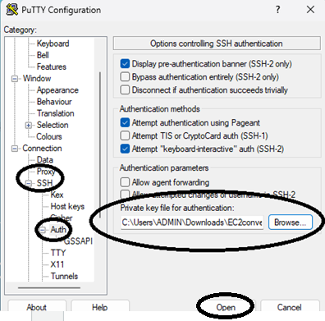

Slide 33
You can connect direct by EC2 linux or
Putty

Slide 34
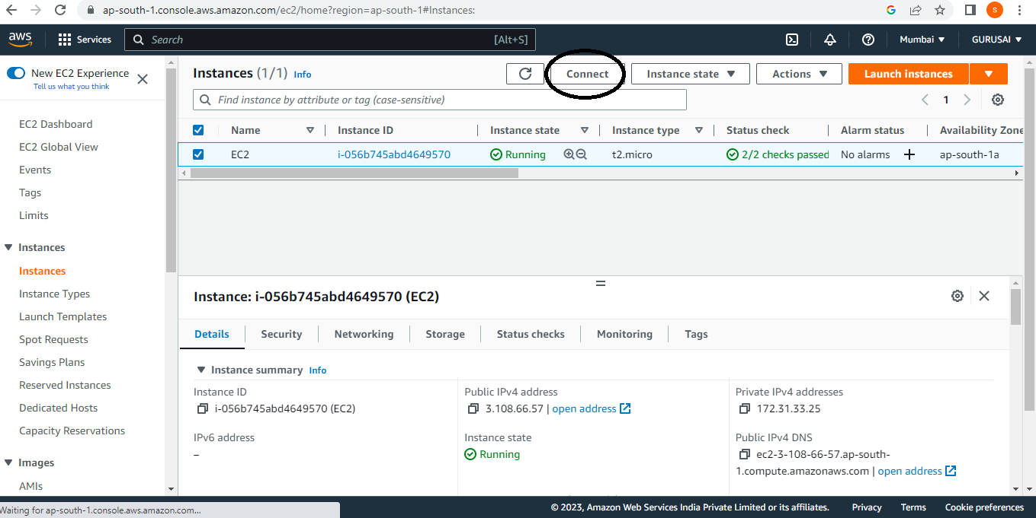
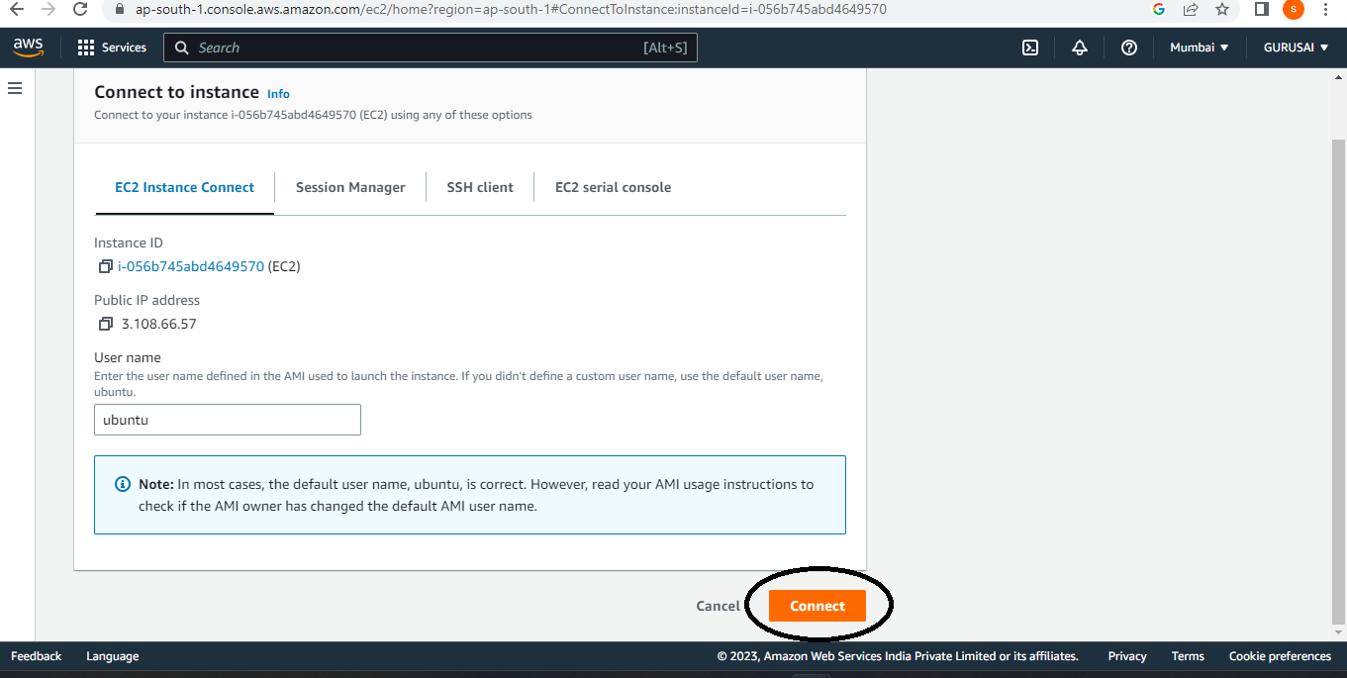
Connecting by EC2 Linux

Slide 35
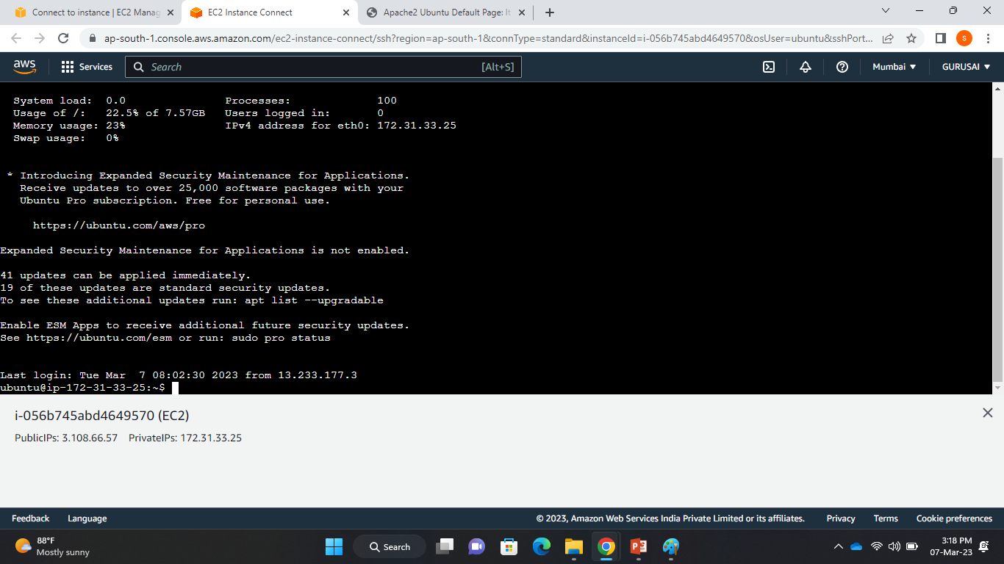
We are into linux terminal

Slide 36
Use the linux commands
Clear-(will clear the page)
Pwd (print working directory (writes the full pathname of the current working directory to the standard output)
sudo apt-get update (package manager for update the software)
Sudo apt-get install apache2 (installing the webserver)
Cd /var/www/html (to find the file location)
ls (listing files)

Slide 37
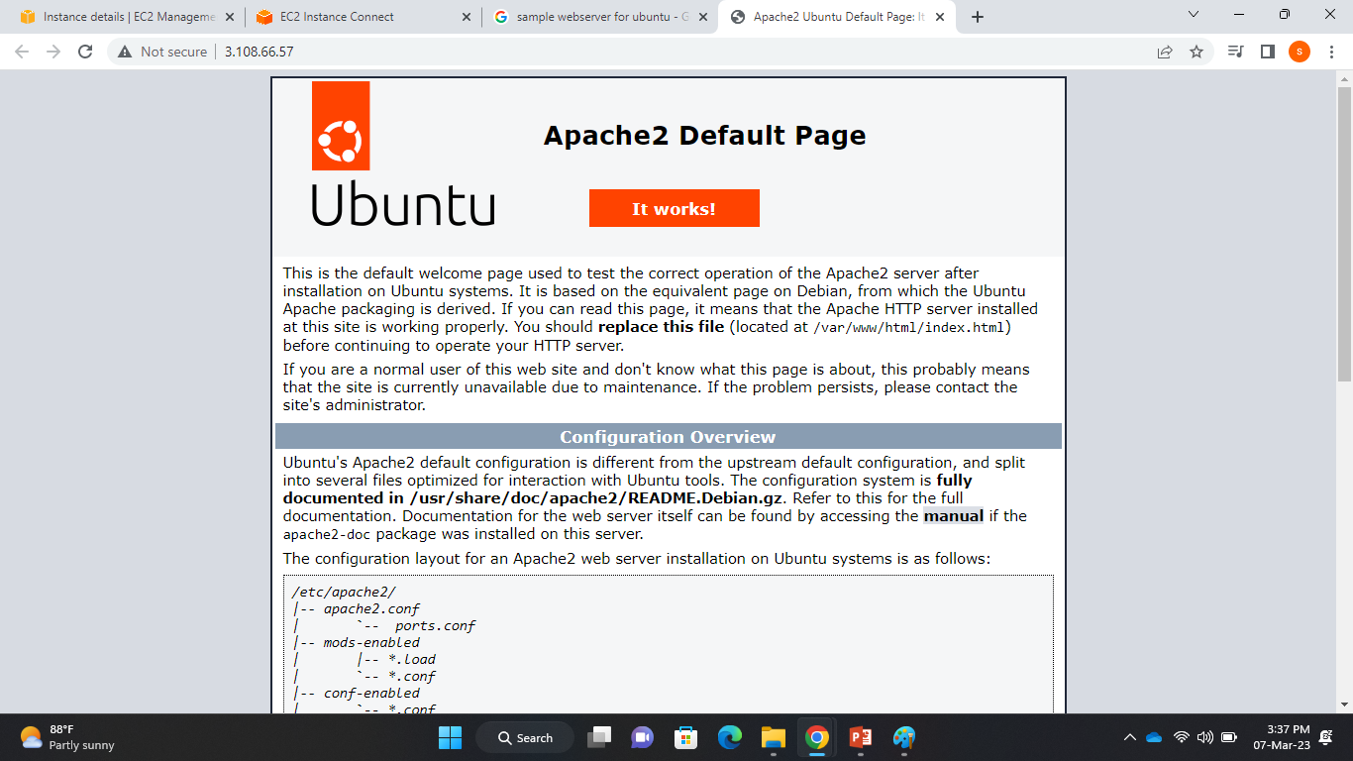
result

Slide 38
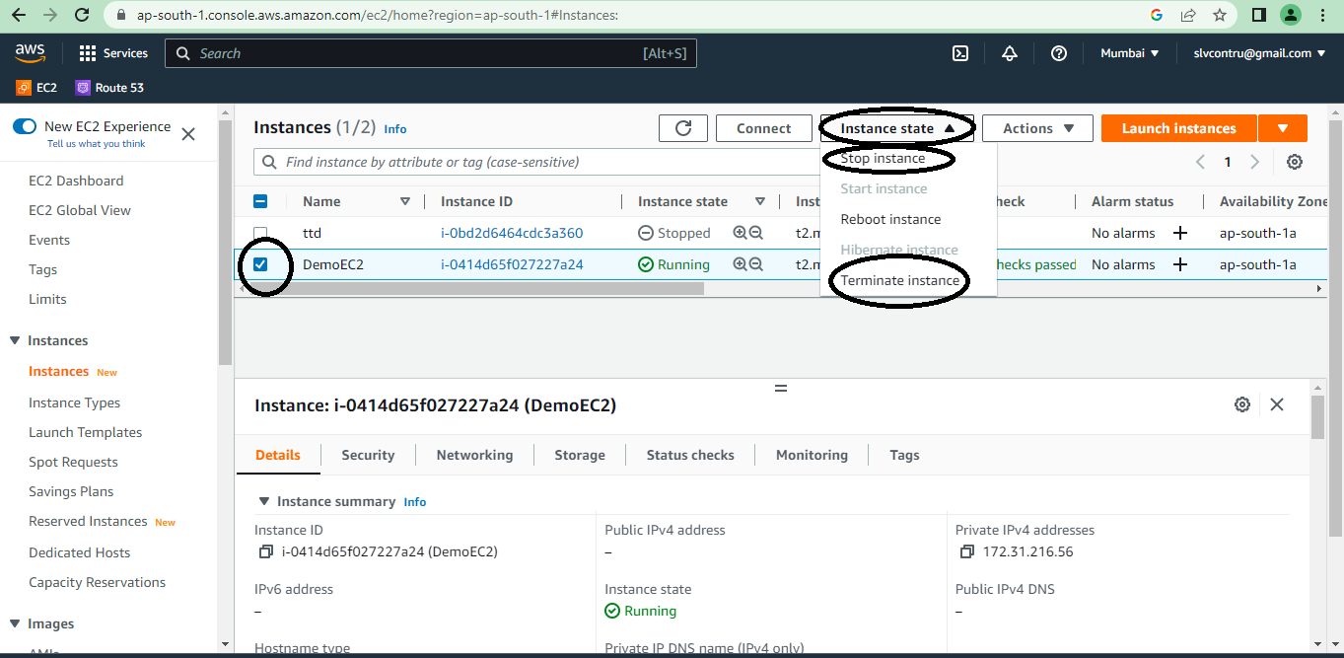
Stop or terminate ec2 instance:

Slide 39
THANK YOU

